Slide 1

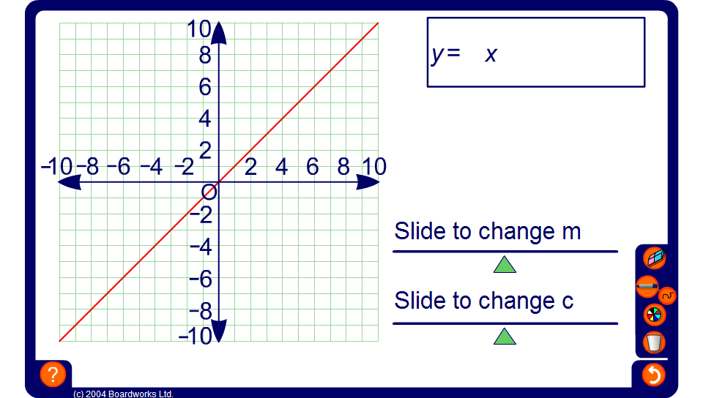


Linear graphs with positive gradients
Notes:
Use this activity to explore the effect of changing the value of the coefficient of x (m) and the value of the number that is added on (c).
Start by keeping c set to 0 to explore graphs of the form y = mx.
Establish that these graphs of this form:
Are straight lines.
Pass through the origin.
Vary in steepness depending on the value of m.
Ask pupils if they can explain why graphs of the form y = mx pass through the origin. Establish that at the origin the x-coordinate is equal to 0. Whatever we multiply 0 by, the answer is always 0. Therefore if x is 0, y is 0, regardless of the value of m, and the point (0, 0) is the origin.
Next, explore graphs of the form y = x + c by keeping m set to 1 and changing the value of c. Establish that graphs of the form y = x + c:
Are straight lines.
Have the same slope as y = x and so are parallel.
Cut (or intersect) the y-axis at c, that is the point (0, c).

